Slide 1
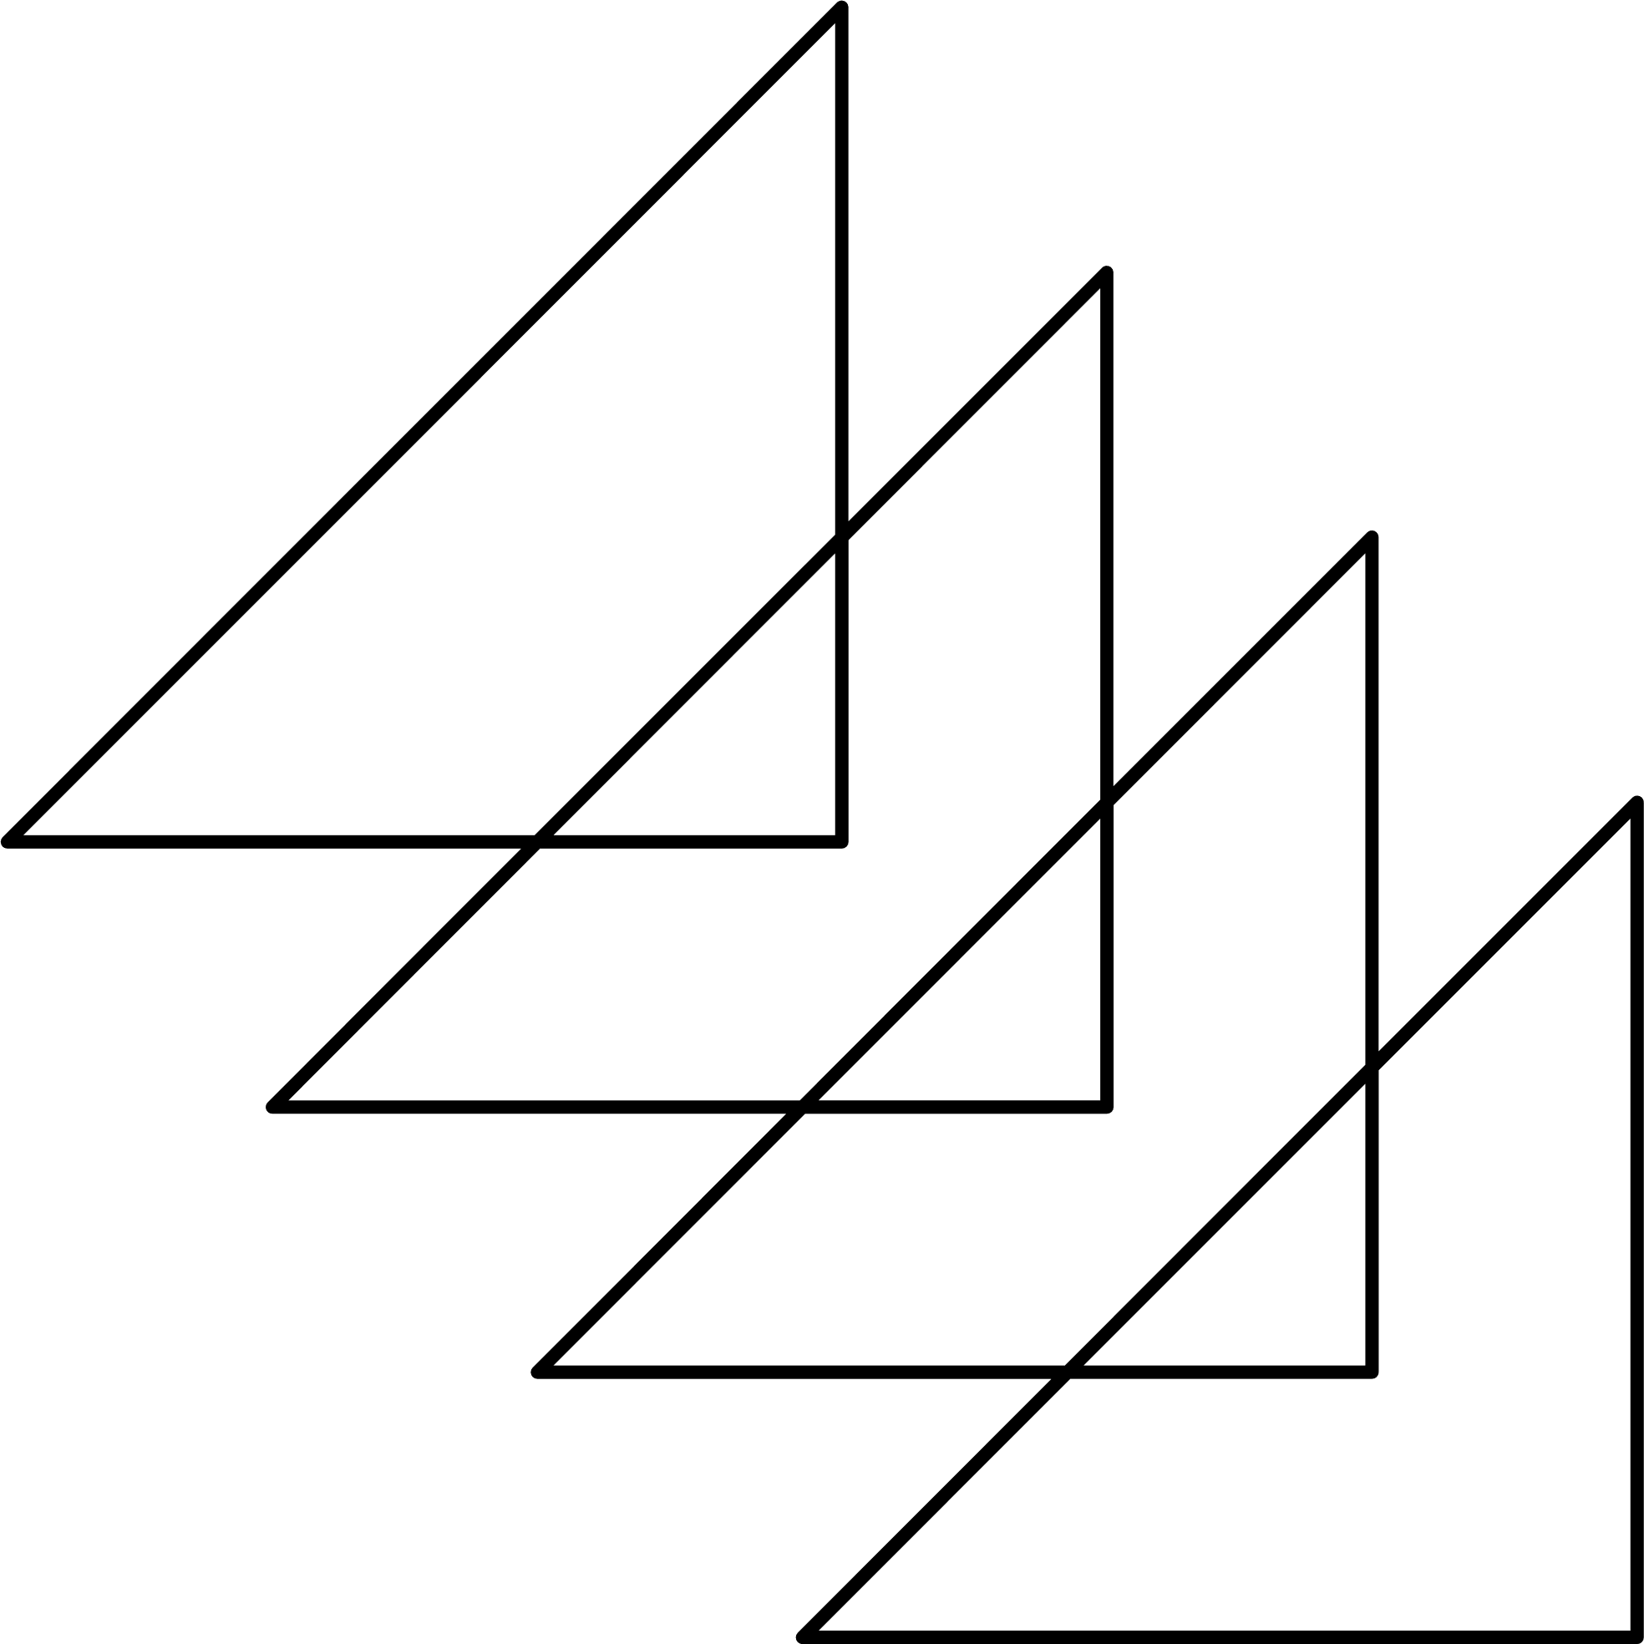
CONTENT
01
05
Result and Visualisation
Introduction
02
06
Code Run-Through
Zones Considered
03
Flowchart
07
Use Case
04
Constraints
08
Area of Improvement

Slide 2
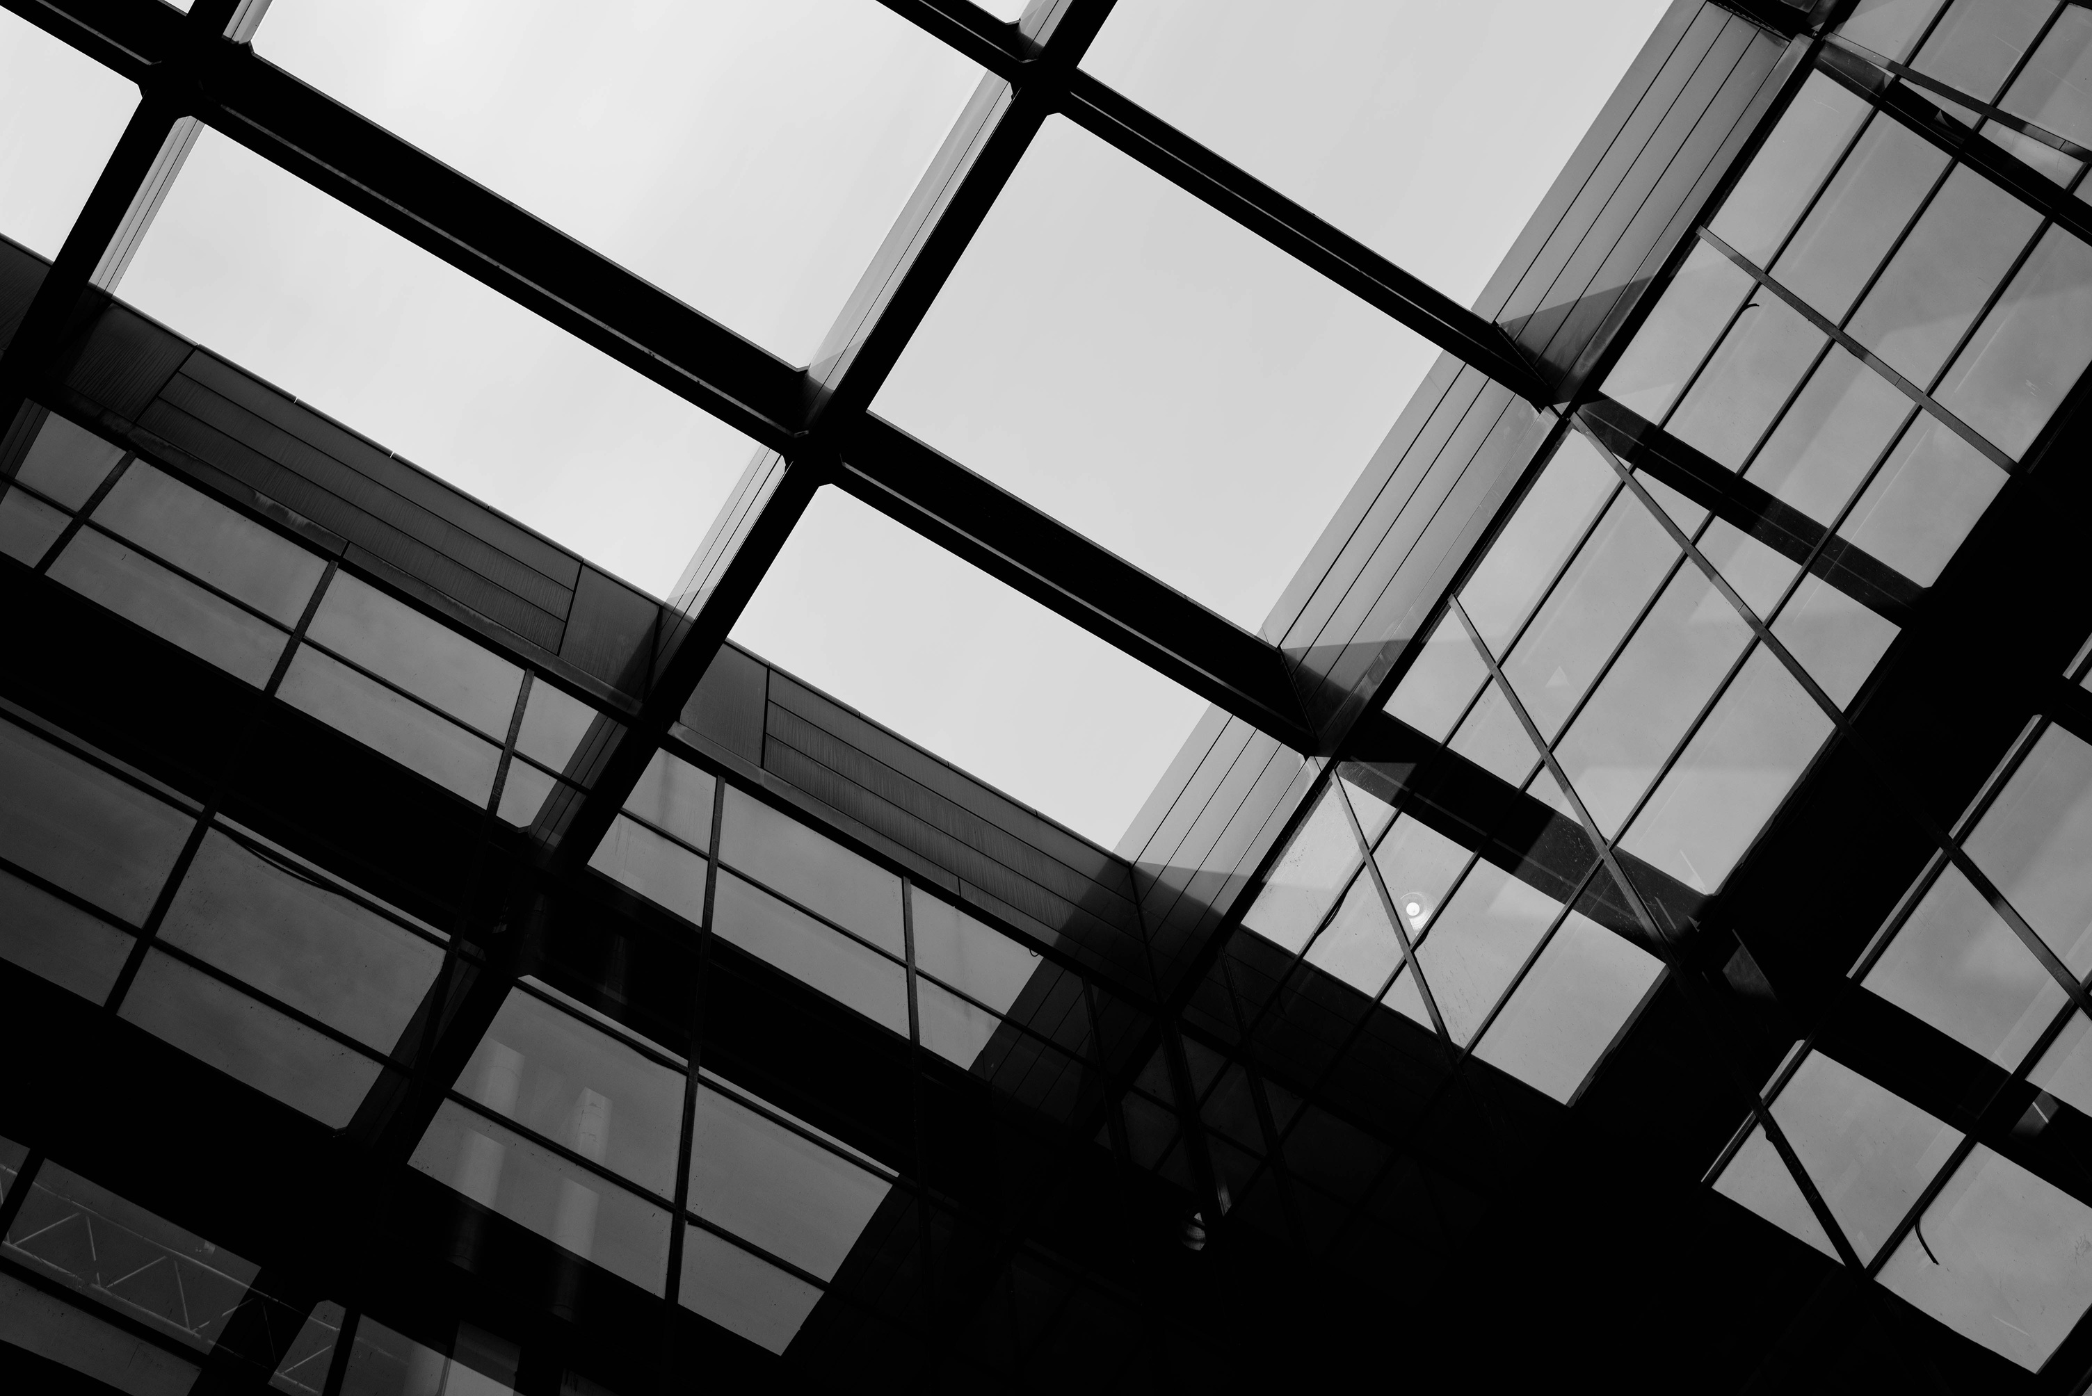
INTRODUCTION
01
02
03
Smart Cities use technology to efficiently create sustainable landscapes that help increase the quality of life.
They integrate data and infrastructure.
The given problem statement emphasized the importance of making the design process faster, according to given criteria. These solutions have to adapt accordingly.
Our code generates a simulated grid by randomly placing various zones like residential, industries, healthcare, etc while ensuring spatial constraints. It then visualizes the entire layout. The random nature of actual cities are considered while creating the algorithm.

Slide 3
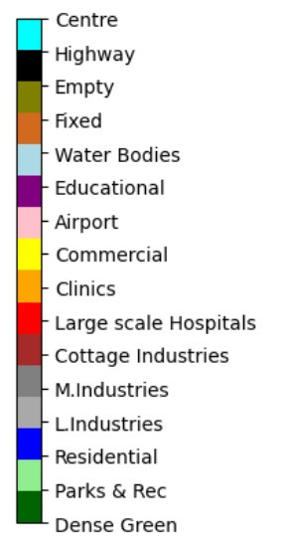
ZONES CONSIDERED
There are 16 zones covering all aspects i.e residential, healthcare, educational, commercial and industrial. Natural features such as parks, forests and water bodies have also been considered.
A basic structure for roads has been depicted. Other than this, airports, highways and railway lines are added for traveling connectivity.
Further zones have been added to account for fixed spaces and a few blocks can be kept empty, for future development.

Slide 4

User inputs total area of the layout first
FLOWCHART
2 options are provided- Customised or default grid
If user selects customised, then number of fixed blocks need to be set, and the coordinates for the same need to be added.
Next, user selects the number of empty blocks to be left in the layout. These can be assigned randomly or at specific coordinates.

Slide 5
User assigns desired percentages for each zone.
A city centre is picked at random, and railways and highways are assigned towards the borders of the grid
FLOWCHART
Remaining area available is calculated, excluding areas covered by fixed and empty blocks and centre and highways
Zones are assigned according to preset conditions, starting with L.Industries, M.Industries, Cottage Industries, and Dense Forests

Slide 6
Commercial, Healthcare, Educational zones along with Parks & Rec, Water Bodies and Airports are randomly placed throughout the remaining area
FLOWCHART
Next, residential zones are placed. Majority are clustered.
We recheck if any condition is unfulfilled and allot zones accordingly.
Conditions for road connectivity is defined and the grid along with the roads is visualised.

Slide 7
CONSTRAINTS
Dense Green areas are present next to Industrial Areas to reduce their carbon footprint. Industrial Areas have been visualised keeping renewable energy in mind. Waste management and energy consumption is supervised.
Industrial areas have been assigned as far as possible from the city centre.
Residential zones are placed in clusters.
To avoid mishaps, buildings close to the airports must have lesser number of levels.
Additionally, fixed zones can be added for the coordinates that the user wants undisturbed.

Slide 8
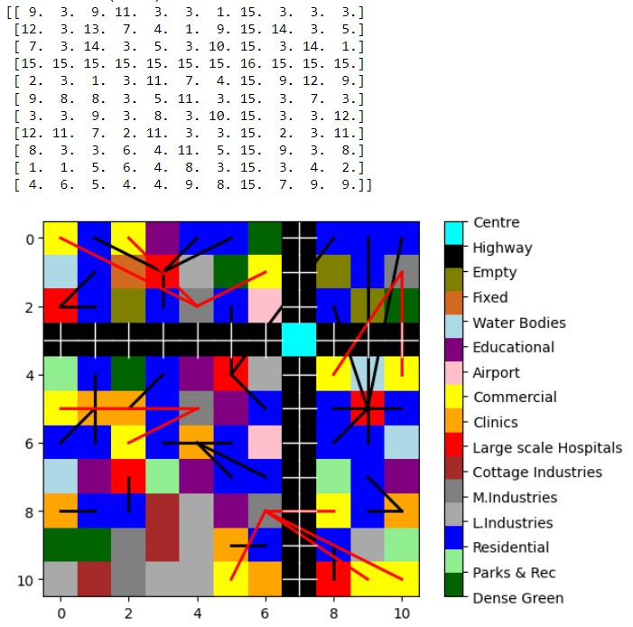
RESULTS
The matrix displayed shows the number-wise allocation for each zone.
Basic structure for roads have been shown too. Residential zones have been connected to Healthcare and Commercial zones are connected to industries.
Accuracy is calculated by comparing actual allocations and the desired percentages for each area.

Slide 9
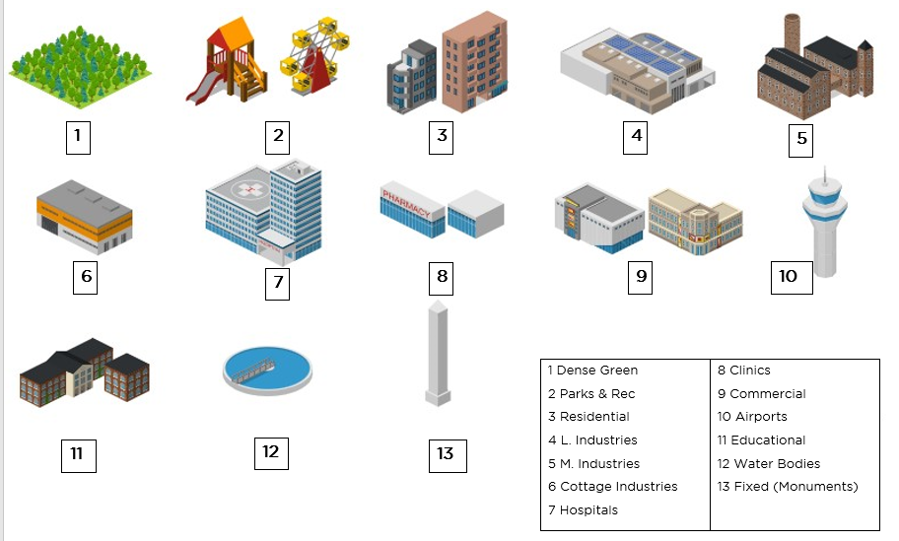
VISUALISATION
Using an online software, we have created an isometric view of the city for better understanding.
We used the grid generated by our code, converted it to a base in isometric view, and added in the graphics

Slide 10
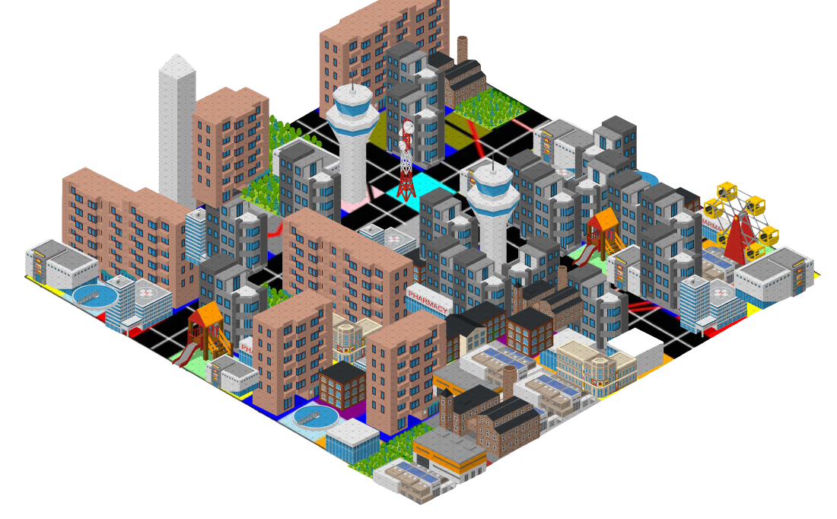
VISUALISATION

Slide 11
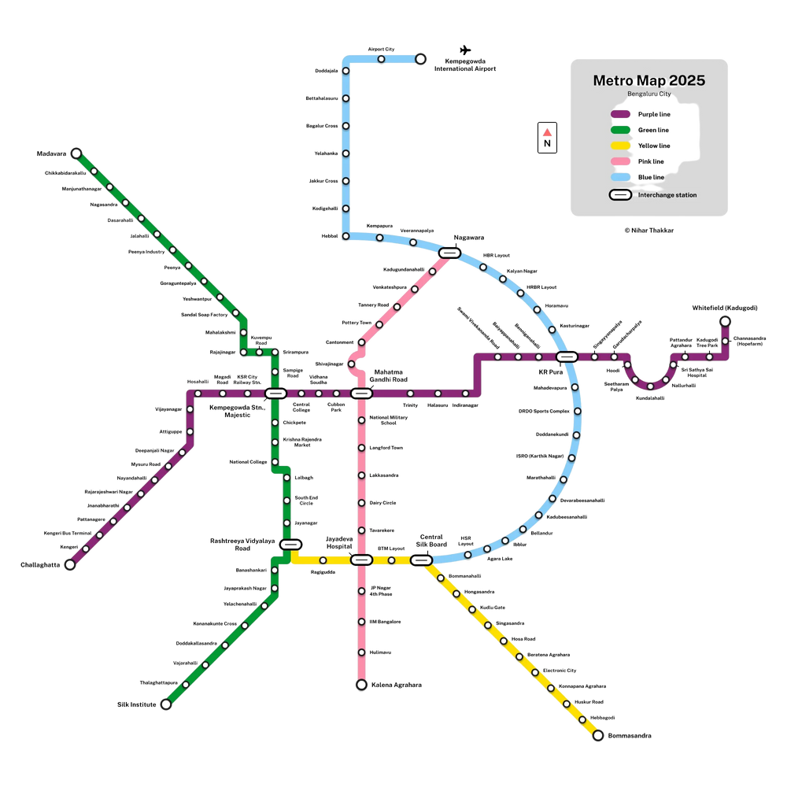
USE CASE
Consider a party wants to convert a city to a smart one, he or she needs to overcome the problems due to space and resource allocation, transport management and sustainability.
Our solution helps them to generate their desired layout.
In our plan, fixed locations and empty spaces have been accounted for. Other than this, sustainability is maintained as industries are powered by renewable energy and forestation is placed right next to it.
For transport, we suggest Metros, Railways, Wider Highways and basic roadways. Metro layouts can be adapted according to existing city maps or future plans, eg: Banglore and Delhi

Slide 12
AREAS OF IMPROVEMENT
Our current layout is in a square shape, cities need not have a fixed shape. Modifications for shapes need to be done.
The road infrastructure is a basic idea and can be scaled as desired.
Amenities such as bus stops, charging stations, surveillance system, etc can be added. Other factors such as Terrain differences can be scaled further.
As it is a smart city, renewable energy methods have been incorporated, but changes can be made.

Slide 13
THANK YOU

